Slide 1
Credit Card Fraud Detection
Capstone Project
ASHISH JAIN
ISHAN RAWAT
ALLAMPRABHU HIREMATH

Slide 2


Slide 3
Introduction:
For many banks, retaining high profitable customers is the number one business goal. Banking fraud, however, poses a significant threat to this goal for different banks. In terms of substantial financial losses, trust and credibility, this is a concerning issue to both banks and customers alike. With the rise in digital payment channels, the number of fraudulent transactions is also increasing with new and different ways.
In the banking industry, credit card fraud detection using machine learning is not just a trend but a necessity for them to put proactive monitoring and fraud prevention mechanisms in place. The objective of this case study is to develop Machine learning models to help these institutions to reduce time-consuming manual reviews, costly chargebacks and fees, and denials of legitimate transactions.

Slide 4
Problem Approach

Slide 5
The project pipeline can be briefly summarized in the following four steps:
Data Understanding
Exploratory data analytics (EDA)
Train/Test Split
Model-Building/Hyperparameter Tuning

Slide 6
Brief overview about the business problem
In simple terms it is nothing but we need to detect a fraud credit card transaction.
So we have a lot of banks who does not want to go into losses based on a fraud transaction.
If there is a fraud transaction then the bank needs to pay the amount to the user customer who have lost the money from his\her card.
The fraud can take place while purchasing through 3rd party websites and even by friends/family who have saved the cards at their shopping apps while purchasing.

Slide 7
Business requirement
We need a machine learning model which can identify a fraud transaction and save the bank from repaying the amount
Which can help the bank grow financially and also, this could help to attract a lot of customer who would feel safe on having a credit from corresponding bank

Slide 8
Data set
-- ------ -----
0 trans_date_trans_time object
1 cc_num int64
2 merchant object
3 category object
4 amt float64
5 first object
6 last object
7 gender object
8 street object
9 city object
10 state object
11 zip int64
12 lat float64
13 long float64
14 city_pop int64
15 job object
16 dob object
17 trans_num object
18 unix_time int64
19 merch_lat float64
20 merch_long float64
21 is_fraud int64 dtypes: float64(5), int64(5), object(12) memory usage: 325.1+ MB
1). Data set mainly consist of categorical columns rather then numerical columns
2). The data used here is the concatenation of the train and test data set provided from kaagle.

Slide 9
Data set quality check
trans_date_trans_time 0.0 cc_num 0.0
merchant 0.0
category 0.0
amt 0.0
first 0.0
last 0.0
gender 0.0
street 0.0
city 0.0
state 0.0
zip 0.0
lat 0.0
long 0.0
city_pop 0.0
job 0.0
dob 0.0
trans_num 0.0
unix_time 0.0
merch_lat 0.0
merch_long 0.0
is_fraud 0.0
dtype: float64
1). Data set looks good without any null or duplicate columns
2). But we have few columns which we are not required and we can remove them during building our model.

Slide 10
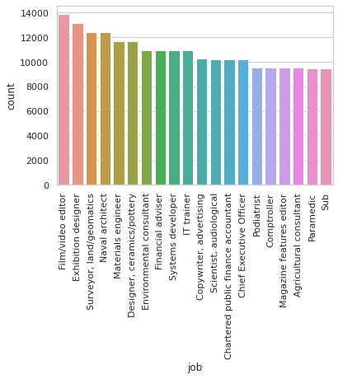
EDA
We try to observe different pattern and combination in the data set using graphs this helps us in understanding the insight of data

Slide 11
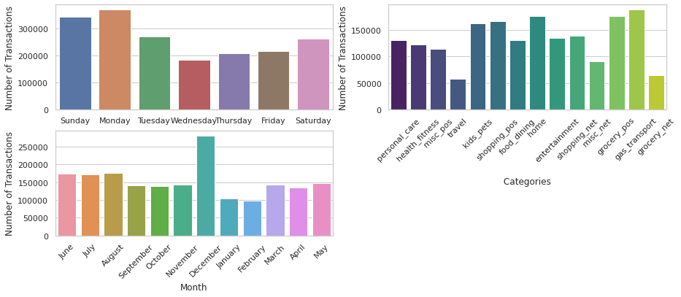
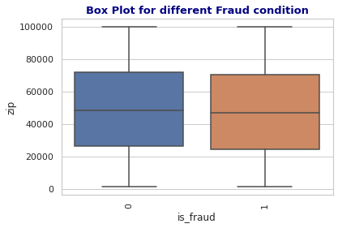
ANALYSIS
Box plot Analysis
Bar graphs Analysis

Slide 12
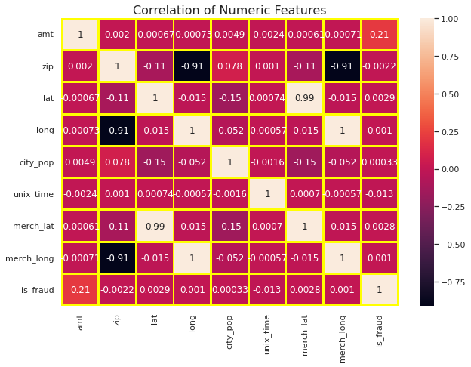
Correlation Heat Map

Slide 13

Requirements for Model Building
Here we were trying to build a logistic regression model so for that we were trying to use the categorical values to convert into numerical formal
Creating dummy variables for better representation
And also , bring few new field which would help model in better training
Notes:
we will create the different models and fine-tune their hyperparameters until we get the desired level of performance on the given dataset.

Slide 14
Following are the followed for creating dumsteps my variables
Converting the data field
Converting the data field for using it to pick new field
Spliting and converting data to days to weeks
Dividing the data field to pick values like
month ,year, date etc
We used data field to get the days of the week

Slide 15
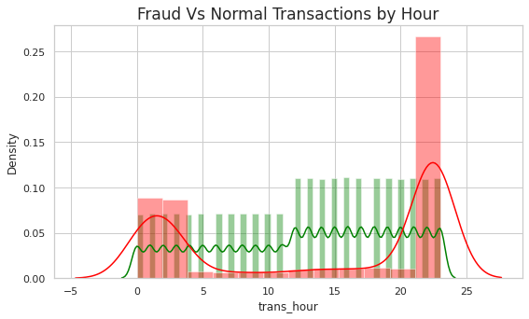
Observation with no. of transaction per hour

Slide 16
Observations
Highest number of transaction are in month of December
Lowest number of transaction happens in February
.

Slide 17
Percentile distribution
Index | Category | Category_Count | Values | Percent
0 | 2 | gas_transport | 188029 | 10.15 %
1 | 4 | grocery_pos | 176191 | 9.51 %
2 | 6 | home | 175460 | 9.47 %
3 | 12 | shopping_pos | 166463 | 8.98 %
4 | 7 | kids_pets | 161727 | 8.73 %
index | Category | category_count | percent
0 | 2 | gas_transport | 188029 | 10.150594
1 | 4 | grocery_pos | 176191 | 9.511529
2 | 6 | home | 175460 | 9.472067
3 | 12 | shopping_pos | 166463 | 8.986371
4 | 7 | kids_pets | 161727 | 8.730702

Slide 18
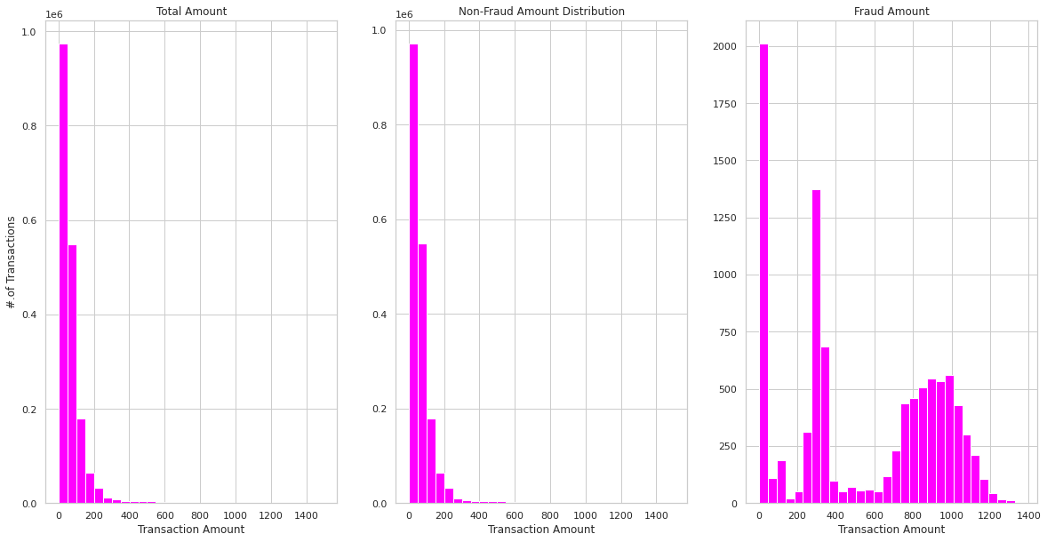

Slide 19
Model training
1).logreg = LogisticRegression(random_state=42)
logreg.fit(X_train, y_train)
y_train_pred = logreg.predict(X_train)
y_test_pred = logreg.predict(X_test)
2).dt_clf = DecisionTreeClassifier(criterion ='gini’, max_depth = 20, random_state=0)
dt_clf.fit(X_train, y_train)
3).from sklearn.ensemble import RandomForestClassifier
rf_clf = RandomForestClassifier(random_state=345)
param_grid = {
'n_estimators': [50],
'max_depth' : [8,16,20]
}
Model building using logistic regression , Decision trees, Random forest

Slide 20
Confusion matrix using logisticregression
precision recall f1-score support
0 0.79 0.92 0.85 1289742
1 0.91 0.75 0.82 1290098
accuracy 0.84 2579840
macro avg 0.85 0.84 0.84 2579840
weighted avg 0.85 0.84 0.84 2579840
1192673 | 97069
322880 | 967218

Slide 21
Confusion matrix using Decisiontree
1282628 | 7114
0 | 1290098
precision recall f1-score support
0 1.00 0.99 1.00 553001
1 0.99 1.00 1.00 552645
accuracy 1.00 1105646
macro avg 1.00 1.00 1.00 1105646
weighted avg 1.00 1.00 1.00 1105646

Slide 22
Confusion matrix using Randomforest
precision recall f1-score support
0 1.00 1.00 1.00 1289742
1 1.00 1.00 1.00 1290098
accuracy 1.00 2579840
macro avg 1.00 1.00 1.00 2579840
weighted avg 1.00 1.00 1.00 2579840
1287366 | 2376
0 | 1290098

Slide 23
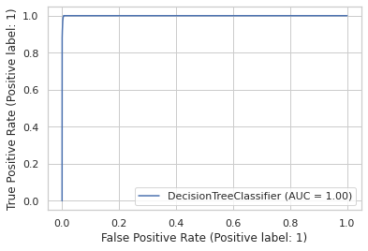
The ROC curve

Slide 24
Cost Benefit Analysis
S. No | Insights | Answer
1 | Average number of transactions per month | 77183.08333
2 | Average number of fraudulent transaction per month | 402.125
3 | Average amount per fraud transaction | 583.5592105

Slide 25
Cost Benefit Analysis
S. No | Insights | Answer
1 | Cost incurred per month before the model was deployed (b*c) | 2,13,392.22
2 | Average number of transactions per month detected as fraudulent by the model (TF) | 1,720
3 | Cost of providing customer executive support per fraudulent transaction detected by the model | 1.5
4 | Total cost of providing customer support per month for fraudulent transactions detected by the model (TF*$1.5) | 2,580.38
5 | Average number of transactions per month that are fraudulent but not detected by the model (FN) | 68
6 | Cost incurred due to fraudulent transactions left undetected by the model (FN*c) | 35,908.09
7 | Cost incurred per month after the model is built and deployed (4+6) | 38,488.46
8 | Final savings = Cost incurred before - Cost incurred after(1-7) | 1,74,903.76

Slide 26
THANK YOU

